Slide 1
Copyright Notice
These slides are distributed under the Creative Commons License.
DeepLearning.AI makes these slides available for educational purposes. You may not use or distribute these slides for commercial purposes. You may make copies of these slides and use or distribute them for educational purposes as long as you cite DeepLearning.AI as the source of the slides.
For the rest of the details of the license, see https://creativecommons.org/licenses/by-sa/2.0/legalcode

Slide 2
Classification
Motivations

Slide 3






Classification
Question
Answer “𝑦”
Is this email spam? no yes Is the transaction fraudulent? no yes Is the tumor malignant? no yes
𝑦 can only be one of two values
false true
0 1
“binary classification”
“negative class”
“positive class”

Slide 4











(yes) 1
malignant?
(no) 0
tumor size 𝑥
(diameter in cm)
benign
malignant

Slide 5





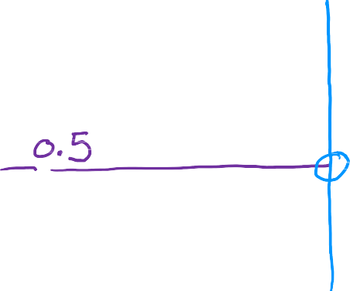
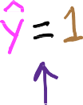





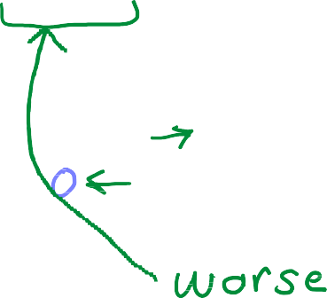














𝑥 = 𝑤𝑥 + 𝑏
^{𝑓}𝑤,𝑏
^{𝑓}𝑤,𝑏
𝑥 = 𝑤𝑥 + 𝑏
(yes) 1
threshold
malignant?
(no) 0
tumor size 𝑥
(diameter in cm)
𝑥 < 0.5 → 𝑦ො = 0
𝑥 ≥ 0.5 → 𝑦ො = 1
if 𝑓_{𝑤,𝑏}
if 𝑓_{𝑤,𝑏}

Slide 6
Classification
Logistic Regression

Slide 7
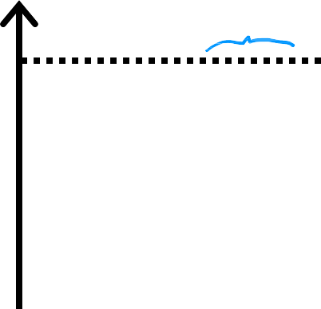




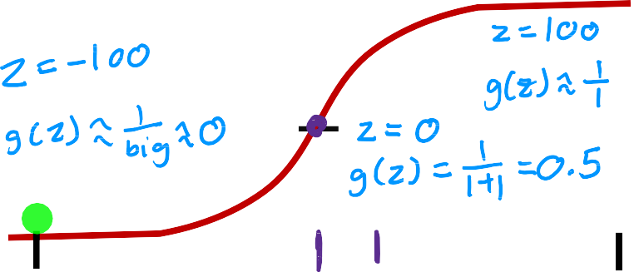







Want outputs between 0 and 1
(yes) 1
threshold
malignant?
1
0.5
0
sigmoid function
logistic function
outputs between 0 and 1
𝑧
3
(no) 0
tumor size 𝑥
(diameter in cm)
-3
₌ 1
𝑔 𝑧
0 < 𝑔 𝑧 < 1
1+𝑒^{−𝑧}

Slide 8



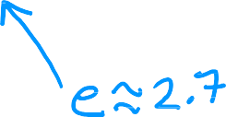

Want outputs between 0 and 1
^{𝑓}w,𝑏
x
w ∙ x + 𝑏
1
𝑧 =
0.5
₌ 1
0
sigmoid function
logistic function
𝑧
3
𝑔 𝑧
1+𝑒^{−𝑧}
-3
1
x = 𝑔(w ∙ x + 𝑏) =
_{1 + 𝑒}− w∙x+𝑏
^{𝑓}w,𝑏
outputs between 0 and 1
“logistic regression”
₌ 1
𝑔 𝑧
0 < 𝑔 𝑧 < 1
1+𝑒^{−𝑧}

Slide 9
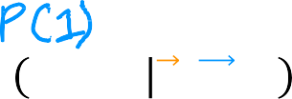
Interpretation of logistic regression output
1
^{𝑓}w,𝑏
x =
_{1 + 𝑒}− w∙x+𝑏
𝑓_{w,𝑏} x = 𝑃 𝑦 = 1 x; w,𝑏
Probability that 𝑦 is 1,
given input x, parameters w,𝑏
“probability” that class is 1
Example:
𝑥 is “tumor size”
𝑦 is 0 (not malignant)
or 1 (malignant)
𝑃(𝑦 = 0) + 𝑃(𝑦 = 1) = 1
^{𝑓}w,𝑏
x = 0.7
70% chance that 𝑦 is 1

Slide 10
Classification
Decision Boundary

Slide 11


1
1
g(z)
→
→ → =
!
→
x = g( w ∙ x + b)
w,b
( )
−₍→w ∙ →x + b₎
0.5
1 + e
= &₍y = 1 '; →w ,b₎
0
z
!→w ,b(^{→x} )
z = →w ∙ →x + b
Is !→_{w ,b(}→x ₎ ≥ 0.5?
Yes: y^ = 1
When is
!→_{w ,b(}→x ₎ ≥ 0.g5(?z) ≥ 0.5
z ≥ 0
→w ∙ →x + b ≥ 0
y^ = 1
No: y^ = 0
< 0
→w ∙ →x + b < 0
1
1 + e^{−z}
g(z) =
_{y}^
= 0

Slide 12
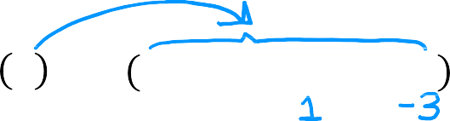


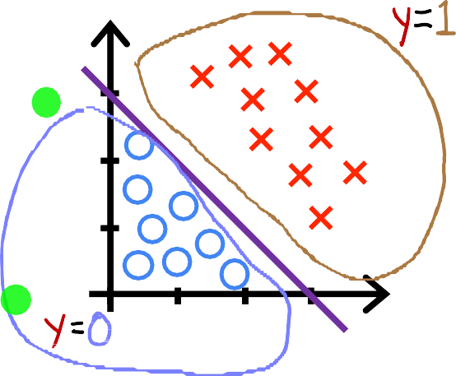
Decision boundary
^{𝑓}w,𝑏
x = 𝑔 𝑧 = 𝑔 𝑤₁𝑥₁ + 𝑤₂𝑥₂ + 𝑏
Decision boundary
𝑧 = w ∙ x + 𝑏 = 0
𝑧 = 𝑥₁ + 𝑥₂ − 3 = 0
𝑥₁ + 𝑥₂ = 3
𝑥₂
3
𝑥₁ + 𝑥₂ ≥ 3
𝑥₁ + 𝑥₂ < 3
2
1
1 2 3
𝑥₁

Slide 13


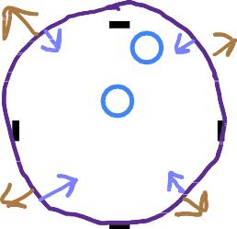




Non-linear decision boundaries
𝑥₂
𝑥 ² + 𝑥 ² ≥ 1
1
2
𝑦ො = 1
𝑓_{w,𝑏} x = 𝑔 𝑧 = 𝑔(
𝑤₁𝑥 ² + 𝑤₂𝑥 ²+b
1 2
)
1
decision boundary
𝑧 = 𝑥 ² + 𝑥 ² − 1 = 0
1 2
𝑥₁
−1
1
𝑥 ² + 𝑥 ² = 1
1 2
−1
𝑥 ² + 𝑥 ² < 1
1
2
𝑦ො = 0

Slide 14




Non-linear decision boundaries
x2
J→_{w ,b(}→x ₎ = g(z) = g(w₁x₁ + w₂x₂
x1
2
2
+w x + w x
x + w x
3 4 1 2
5
1
2
3
+ w x +⋯+ b)
6
1
x2
x1

Slide 15
Cost Function
Cost Function for Logistic Regression

Slide 16








Training set
tumor size (cm)
… patient’s age malignant?
𝑖 = 1, … , 𝑚
𝑗 = 1, … , 𝑛
10 |  | 52 | 1
2 |  | 73 | 0
5 |  | 55 | 0
12 |  | 49 | 1
… |  | … | …
target 𝑦 is 0 or 1
1
𝑓_{w,𝑏} x =
_{1 + 𝑒}− w∙x+𝑏
How to choose w = [^{𝑤}1
𝑤₂ ⋯
^{𝑤}𝑛] and 𝑏?

Slide 17






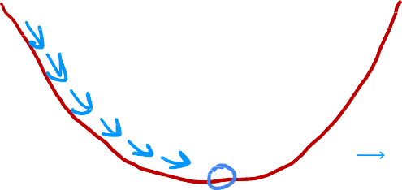


Squared error cost
average of training set
_{x} 𝑖
, 𝑦 ^{𝑖}
^{𝐿 𝑓}w,𝑏
linear regression
logistic regression
1
𝑓_{w,𝑏} x = w ∙ x + 𝑏
^{𝑓}w,𝑏 ^{x}
=
_{1 + 𝑒}− w∙x+𝑏
𝐽 w, 𝑏
convex
non-convex
𝐽 w, 𝑏
w, b
w, 𝑏

Slide 18







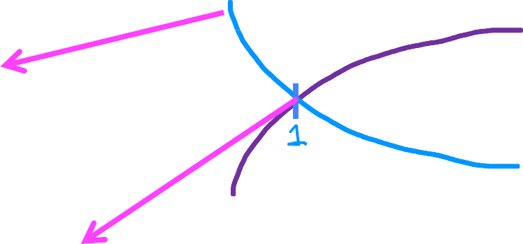
















Logistic loss function
log 𝑓
_{x} 𝑖
, 𝑦 ^{𝑖}
^{𝐿 𝑓}w,𝑏
𝑓
if 𝑦 ^{𝑖} = 1
−log 𝑓
Loss is lowest when
_{x} 𝑖
_{x} 𝑖
⁰ 0.1
0.5
1
_{x} 𝑖
_{x} 𝑖
→ 1 then loss → 0
→ 0 then loss → ∞
^{𝑓}w,𝑏
predicts
As 𝑓
^{𝑓}w,𝑏
w,𝑏
close to true label 𝑦 ^{𝑖} .
As 𝑓
w,𝑏

Slide 19





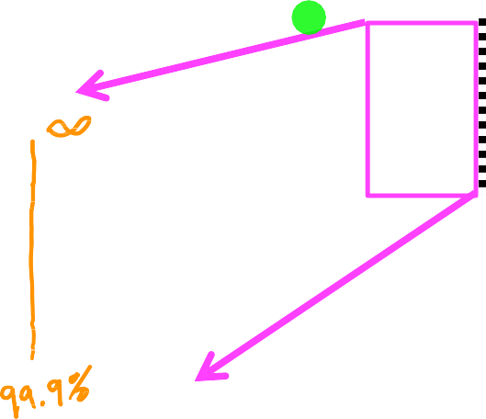
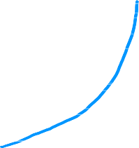












Logistic loss function
−log 1 − 𝑓
As 𝑓_{w,𝑏}
_{x} 𝑖
→ 0 then loss → 0
𝑓
_{x} 𝑖
, 𝑦 ^{𝑖}
^{𝐿 𝑓}w,𝑏
if 𝑦 ^{𝑖} = 0
The further prediction
_{x} 𝑖
is from
^{𝑓}w,𝑏
0
As 𝑓_{w,𝑏}
_{x} 𝑖
target 𝑦 ^{𝑖} , the higher the loss.
^{𝑓}w,𝑏
1
_{x} 𝑖
→ 1 then loss → ∞

Slide 20

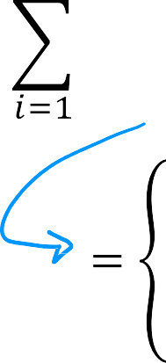
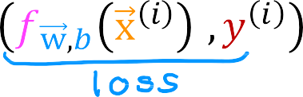

















Cost

Slide 21
Cost Function
Simplified Cost Function for Logistic Regression

Slide 22
















Simplified loss function
_{x} 𝑖
, 𝑦 ^{𝑖}
= − 𝑦 ^{𝑖} log
_{x} 𝑖
− 1 − 𝑦 ^{𝑖} log
1 − 𝑓_{w,𝑏}
_{x} 𝑖
^{𝐿 𝑓}w,𝑏
^{𝑓}w,𝑏
if 𝑦 ^{𝑖} = 1:
_{x} 𝑖
, 𝑦 ^{𝑖} =
^{𝐿 𝑓}w,𝑏

Slide 23









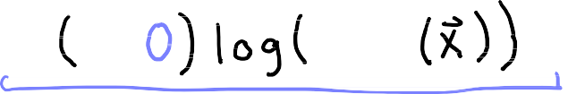



Simplified loss function
_{x} 𝑖
, 𝑦 ^{𝑖}
= − 𝑦 ^{𝑖} log
_{x} 𝑖
− 1 − 𝑦 ^{𝑖} log
1 − 𝑓_{w,𝑏}
_{x} 𝑖
^{𝐿 𝑓}w,𝑏
^{𝑓}w,𝑏
if 𝑦 ^{𝑖} = 1:
_{x} 𝑖
, 𝑦 ^{𝑖} =
^{𝐿 𝑓}w,𝑏
if 𝑦 ^{𝑖} = 0:
_{x} 𝑖
, 𝑦 ^{𝑖} =
^{𝐿 𝑓}w,𝑏

Slide 24
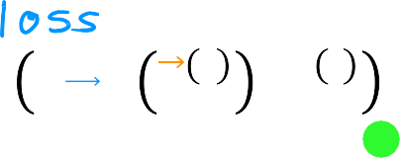
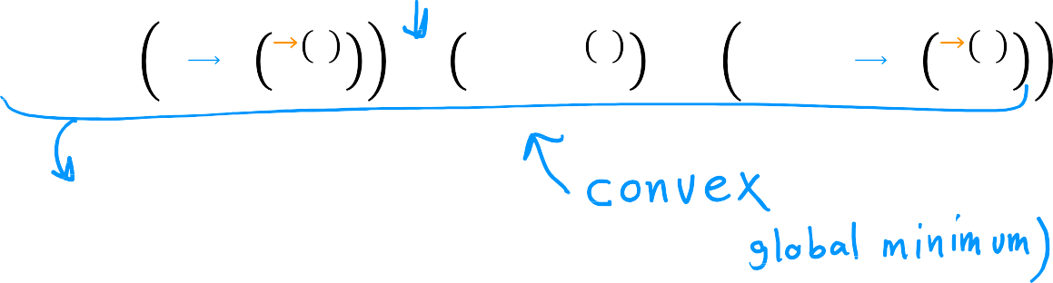


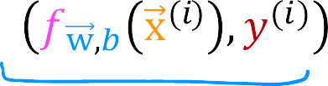














Simplified cost function
_{x} 𝑖
, 𝑦 ^{𝑖} = − 𝑦 ^{𝑖} log
_{x} 𝑖
− 1 − 𝑦 ^{𝑖}
log 1 − 𝑓_{w,𝑏}
_{x} 𝑖
^{𝐿 𝑓}w,𝑏 ^{𝑓}w,𝑏
𝐽 w, 𝑏 =

Slide 25
Gradient Descent
Gradient Descent Implementation

Slide 26
Training logistic regression
Find w, 𝑏
Given new x, output 𝑓 x =
1
w,𝑏
_{1+𝑒}−(w∙x+𝑏)
𝑃 𝑦 = 1 x; w, 𝑏

Slide 27







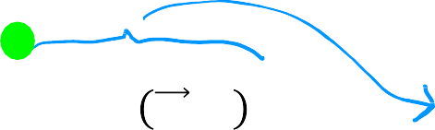





Gradient descent
repeat {
𝑚
𝜕
𝜕
1
𝐽 w, 𝑏 = ෍ (𝑓
_{x} 𝑖
𝑤_{𝑗} = 𝑤_{𝑗} − 𝛼 𝐽 w, 𝑏
− 𝑦 ^{𝑖} )𝑥 ^{𝑖}
𝜕𝑤
𝜕𝑤_{𝑗}
𝑚
w,𝑏
𝑗
𝑗
𝑖=1
𝜕
𝑏 = 𝑏 − 𝛼 𝐽 w, 𝑏
𝑚
𝜕
1
_{x} 𝑖
𝜕𝑏
𝐽 w, 𝑏
= ෍ (𝑓_{w,𝑏}
− 𝑦 ^{𝑖} )
𝜕𝑏
𝑚
𝑖=1
}
simultaneous updates

Slide 28
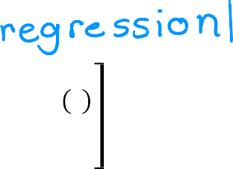




Gradient descent for logistic regression
repeat {
𝑚
1
𝑤_{𝑗} = 𝑤_{𝑗} − 𝛼 ෍ (𝑓
_{x} 𝑖
− 𝑦 ^{𝑖} )𝑥 ^{𝑖}
𝑚
w,𝑏
𝑗
𝑖=1
𝑚
1
𝑏 = 𝑏 − 𝛼 ෍ (𝑓
_{x} 𝑖
Same concepts:
− 𝑦 ^{𝑖} )
𝑚
w,𝑏
Monitor gradient descent (learning curve)
Vectorized implementation
Feature scaling
𝑖=1
}
simultaneous updates
x = w ∙ x + 𝑏
1
Linear regression
^{𝑓}w,𝑏
Logistic regression
𝑓 x
=
w,𝑏
_{1 + 𝑒}(−w∙x+𝑏)

Slide 29
Regularization to Reduce Overfitting
The Problem of Overfitting

Slide 30
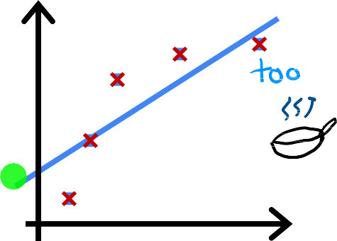
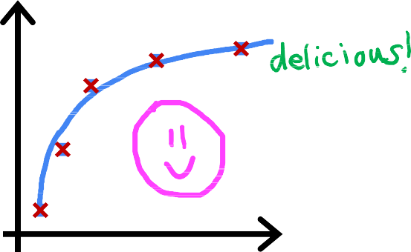
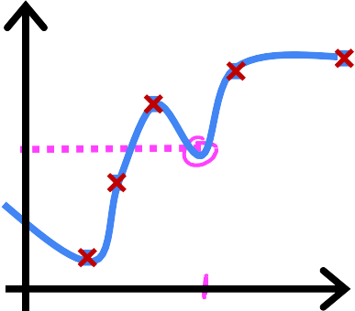
























Regression example
price
price
price
size
𝑤₁𝑥 + 𝑏
size
𝑤₁𝑥 + 𝑤₂𝑥 ² + 𝑏
size
𝑤 𝑥 + 𝑤 𝑥 ² + 𝑤 𝑥 ³ + 𝑤 𝑥 ⁴ + 𝑏
1 2 3 4
Does not fit the training set well
Fits training set pretty well
Fits the training set extremely well

Slide 31




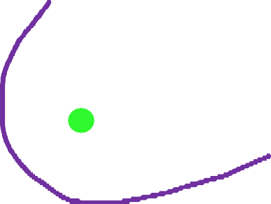












































Classification
𝑥₂
𝑥₂
𝑥₂
𝑥₁
𝑧 = 𝑤₁𝑥₁ + 𝑤₂𝑥₂ + 𝑏
𝑥₁
𝑧 = 𝑤₁𝑥₁ + 𝑤₂𝑥₂
𝑥₁
𝑧 = 𝑤₁𝑥₁ + 𝑤₂𝑥₂
𝑓_{w,𝑏} x = 𝑔 𝑧
+𝑤₃𝑥 ² + 𝑤₄𝑥 ²
+𝑤 𝑥 ²𝑥 + 𝑤 𝑥 ²𝑥 ²
1 2
3 1 2 4 1 2
+𝑤₅𝑥₁𝑥₂ + 𝑏
+𝑤₅𝑥 ²𝑥³ + 𝑤₆𝑥 ³𝑥₂
𝑔 is the sigmoid function
1 2
+ ⋯ + 𝑏
1

Slide 32
Regularization to Reduce Overfitting
Addressing Overfitting

Slide 33






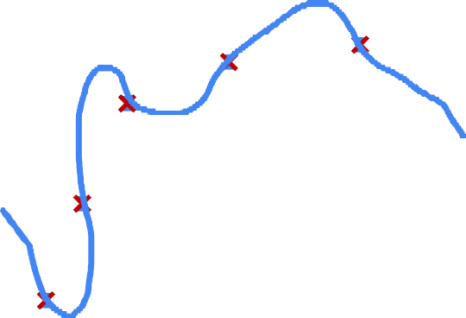
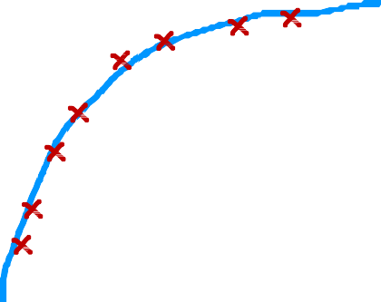

Collect more training examples
price
price
size
size

Slide 34
















Select features to include/exclude
size | bedrooms | floors | age | avg | … | distance to | price
 |  |  |  | income |  | coffee shop
all features
selected features
disadvantage
insufficient data
useful features could be lost

Slide 35


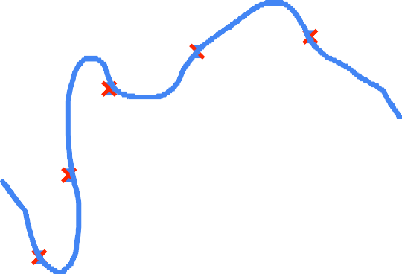













Regularization
Reduce the size of parameters 𝑤_{𝑗}
price
price
features
𝑓 𝑥 = 28𝑥 − 385𝑥 ² + 39𝑥 ³ − 174𝑥 ⁴ + 100
features
𝑓 𝑥 = 13𝑥 − 0.23𝑥 ² + 0.000014𝑥 ³ − 0.0001 𝑥 ⁴ + 10

Slide 36





Addressing overfitting
Options
Collect more data
Select features
  Feature selection
Reduce size of parameters
  “Regularization”

Slide 37
Regularization to Reduce Overfitting
Cost Function with Regularization

Slide 38
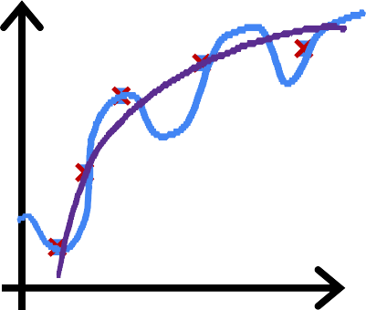



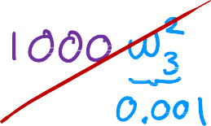


Intuition
price
price
size
𝑤₁𝑥 + 𝑤₂𝑥 ² + 𝑏
make 𝑤₃, 𝑤₄ really small (≈ 0)
size
𝑤₁𝑥 + 𝑤₂𝑥 ² + 𝑤₃𝑥 ³ + 𝑤₄𝑥 ⁴ + 𝑏
𝑚
1
min ෍ 𝑓
_{x} 𝑖
2
− 𝑦 ^{𝑖}
w,𝑏 2𝑚
w,𝑏
𝑖=1

Slide 39












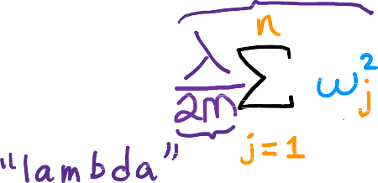
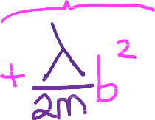









Regularization
small values 𝑤₁, 𝑤₂, ⋯ , 𝑤_{𝑛}, 𝑏
simpler model
less likely to overfit
size | bedrooms | floors | age | avg | … | distance to | price
 |  |  |  | income |  | coffee shop
𝑤₁ , 𝑤₁, 𝑤₂, ⋯ , 𝑤₁₀₀, 𝑏

Slide 40

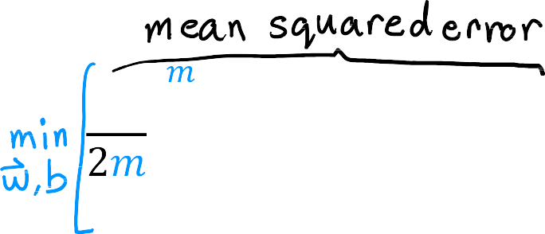
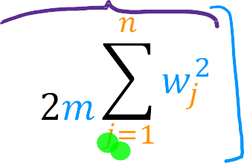









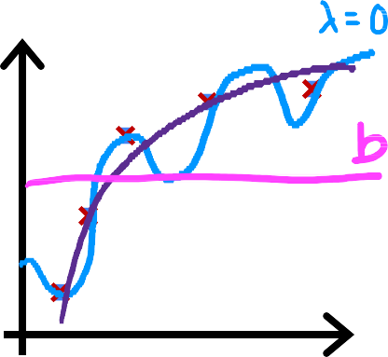








Regularization
choose 𝜆 = 10¹⁰
price
^{𝑓}w,𝑏
x = 𝑤₁𝑥 + 𝑤₂𝑥² + 𝑤₃ 𝑥³ + 𝑤₄𝑥⁴ + 𝑏

Slide 41
Regularization to Reduce Overfitting
Regularized Linear Regression

Slide 42





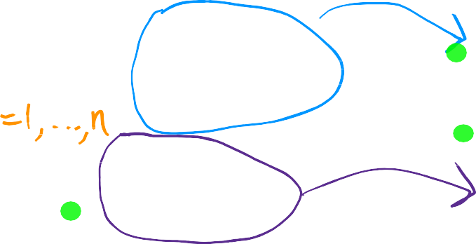






Regularized linear regression
Gradient descent
repeat {
𝜕
𝑤_{𝑗} = 𝑤_{𝑗} − 𝛼
𝐽 w, 𝑏
𝜕𝑤
𝑗
𝜕
𝑏 = 𝑏 − 𝛼
𝐽 w, 𝑏
𝜕𝑏
} simultaneous update

Slide 43






Implementing gradient descent
repeat {
} simultaneous update

Slide 44
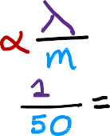
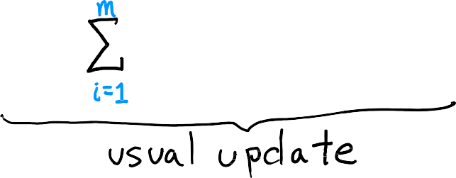
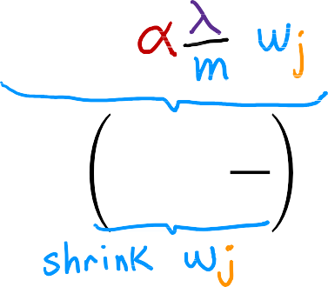


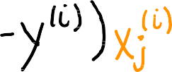





Implementing gradient descent
repeat {
} simultaneous update
𝜆
𝑤_{𝑗} 1 − 𝛼 _{𝑚}

Slide 45
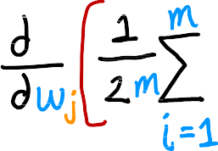

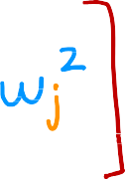
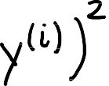
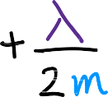





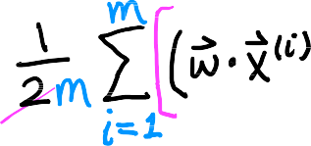
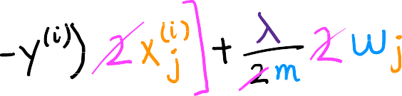

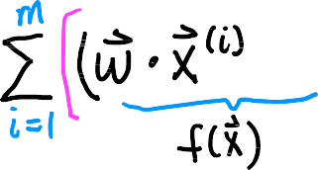
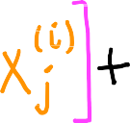






How we get the derivative term (optional)
𝜕
𝐽 w, 𝑏 =
𝜕𝑤_{𝑗}

Slide 46
Regularization to Reduce Overfitting
Regularized Logistic Regression

Slide 47







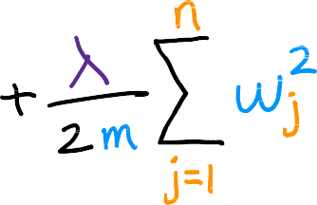


Regularized logistic regression
𝑧 = 𝑤₁𝑥₁ + 𝑤₂𝑥₂
+𝑤₃𝑥 ²𝑥₂ + 𝑤₄𝑥 ²𝑥 ²
1 1 2
+𝑤₅𝑥 ²𝑥 ³ + ⋯ + 𝑏
1 2
𝑥₂
1
x =
1 + 𝑒^{−𝑧}
^{𝑓}w,𝑏
𝑥₁
Cost function
+ 1 − 𝑦 ^{𝑖} log 1 − 𝑓
𝑚
1
𝐽 w, 𝑏 = − ෍ 𝑦 ^{𝑖} log 𝑓
_{x} 𝑖
_{x} 𝑖
𝑚
w,𝑏
w,𝑏
𝑖=1
𝐽 w, 𝑏

Slide 48




















Regularized logistic regression
𝑚
𝑛
1
𝐽 w, 𝑏 = − ෍ 𝑦 ^{𝑖} log 𝑓
_{x} 𝑖
_{x} 𝑖
𝜆
+ 1 − 𝑦 ^{𝑖} log 1 − 𝑓
+ ෍ 𝑤 ²
𝑚
w,𝑏
w,𝑏
2𝑚
𝑗
𝑖=1
𝑗=1
Gradient descent
repeat {
𝜕
𝑤_{𝑗} = 𝑤_{𝑗} − 𝛼
𝐽 w, 𝑏
𝜕𝑤
𝑗
𝜕
𝑏 = 𝑏 − 𝛼
}
𝐽 w, 𝑏
𝜕𝑏

